Slide 1


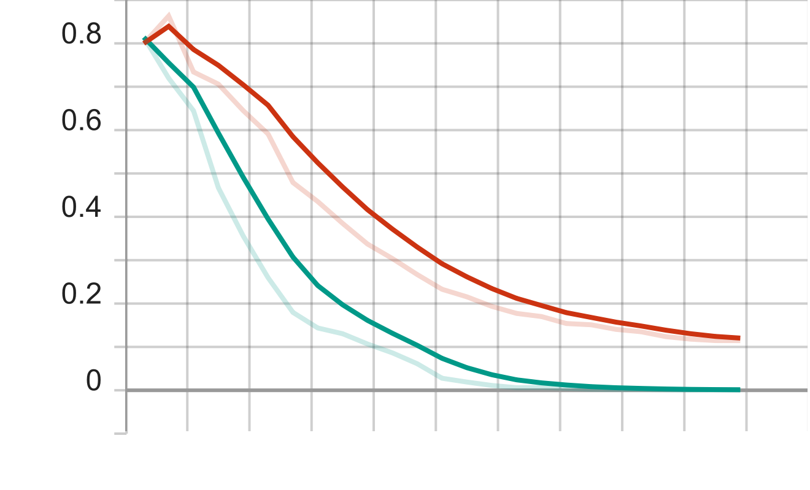
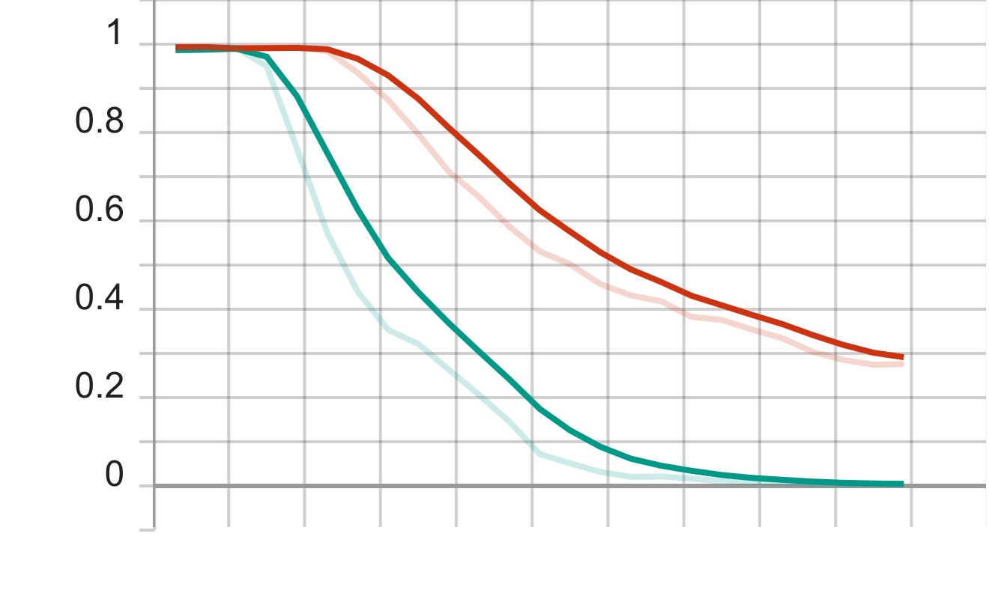
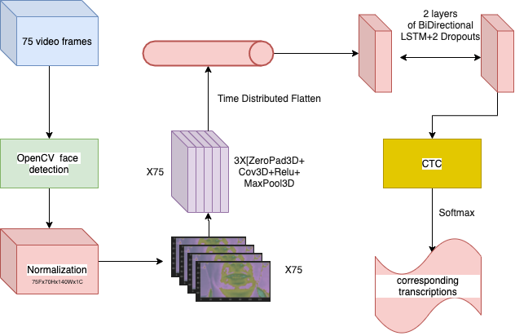
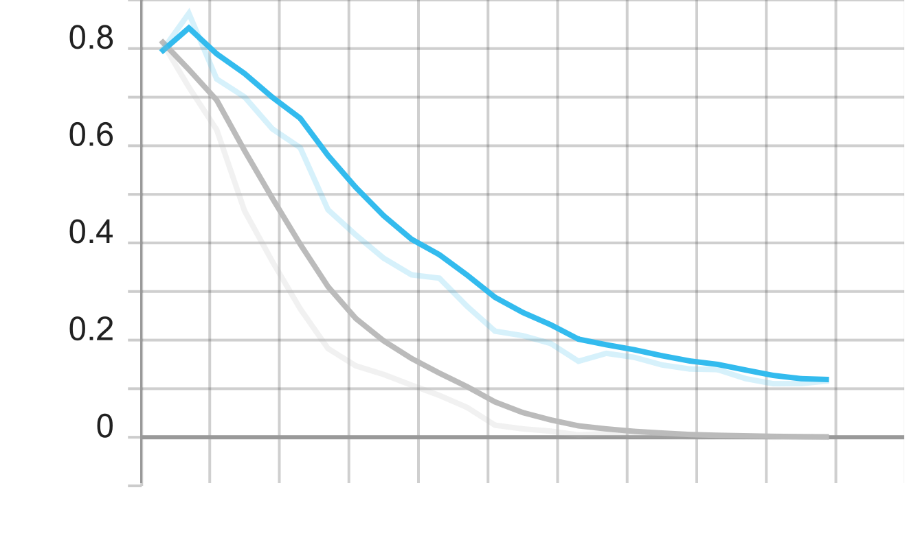
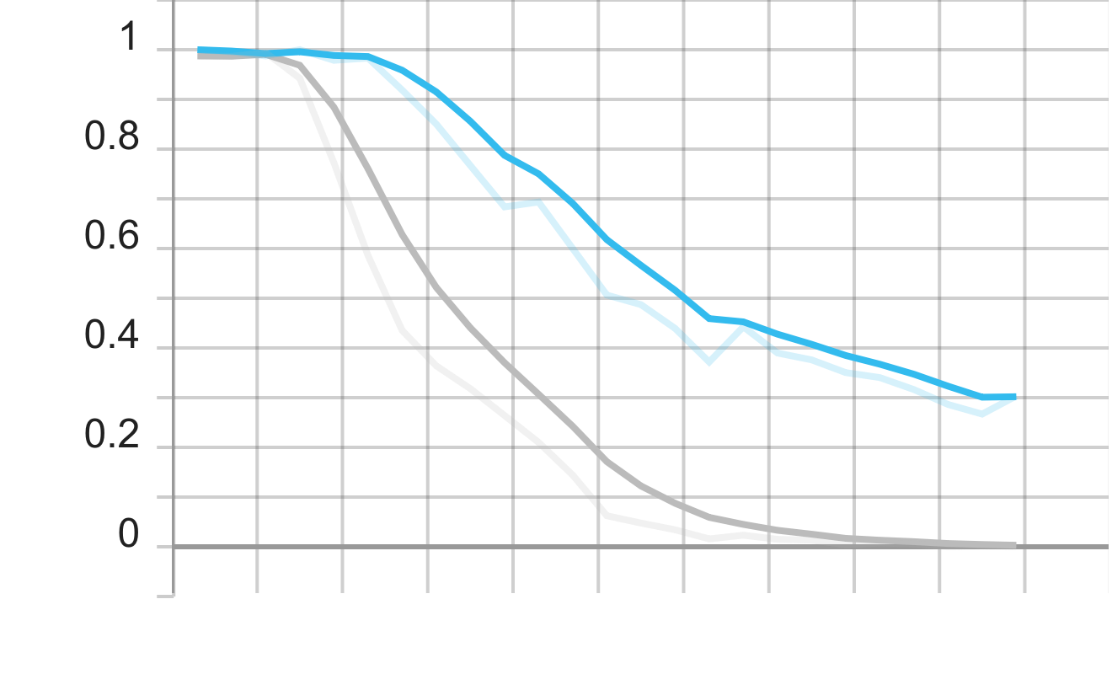

Deciphering Silent Speech: A Multi-dimensional Neural Network Approach Using Conv3D, LSTM, and CTC for Lip-reading
Scan for Code
Zhenyi Li¹, Enda Farrell ²
¹ Master student, Software Engineering – MSc
² Supervisor, Department of Computer and Software Engineering, Technological University of The Shannon: Midlands Midwest
Abstract: A computer vision system characterising the displacement and bending angle of ionic polymer–metal composites (IPMC) was proposed in this study. This study utilised Python (version 3.10) in conjunction with OpenCV (version 4.5.5.64) for the development of the vision system. Measurements generated from the vision system were compared to approximated values via a manual calculation method. Good agreement was found between the results produced by the two methods. The mean absolute error (MAE) and root mean squared error (RMSE) for the displacement values are 0.068080668 and 0.088160652, respectively, and 0.081544205 and 0.103880163, respectively, for the bending angle values.
Results and Discussion: Measurements generated from the vision system were experimentally compared to approximated values via the manual calculation method. Visually inspecting the displacements and bending angle values obtained from both methods, the results generally follow the same trend with no significant deviations between one another. Deviations in results between the manual method and the vision system were statistically calculated using mean absolute error (MAE) and root mean squared error (RMSE).
trian cer
trian wer
Introduction: Ionic polymer–metal composites (IPMCs) are a subset of electroactive polymers known for their sensing and actuating abilities.
valian cer
valiationwer
fig 1
Conclusion: A computer vision system was proposed to measure the displacement and bending angle of ionic polymer-metal composite (IPMC) utilising Python in conjunction with OpenCV. The logical progression was laid out and mathematical formulas used were mentioned. Measurements generated from the vision system were experimentally compared to approximated values via the manual calculation method. Good agreement was found between the results produced by the two methods.
Methodology: The logical progression of the vision system to measure the tip-to-tip displacement and bending angle of IPMCs is given in the flowchart. OpenCV (version 4.5.5.64), an open-source computer vision library, was utilised for this system in conjunction with Python (version 3.1). The tip-to-tip displacement was calculated using Pythagoras's theorem, and the bending angle using the Cosine rule.
Future Work: This study is part of a larger research looking at the manufacturing of IPMCs. Several methods exist in producing them, but conventionally an electroless plating approach is utilised to deposit platinum electrodes onto the Nafion-117 membrane.
Logical progression of the vision system
Acknowledgments
Fbmlfmb;lfdmb;lmblm’blmfgmbLmb’lm;Lamf@Lmb’Amb’lmb’lam’bLma;lmfb;lm

